Slide 1
Deep Learning Classifier (with dropout, batch normalization and data augmentation)
Using CIFAR-10 dataset With Keras
Nedal Ahmad

Slide 2
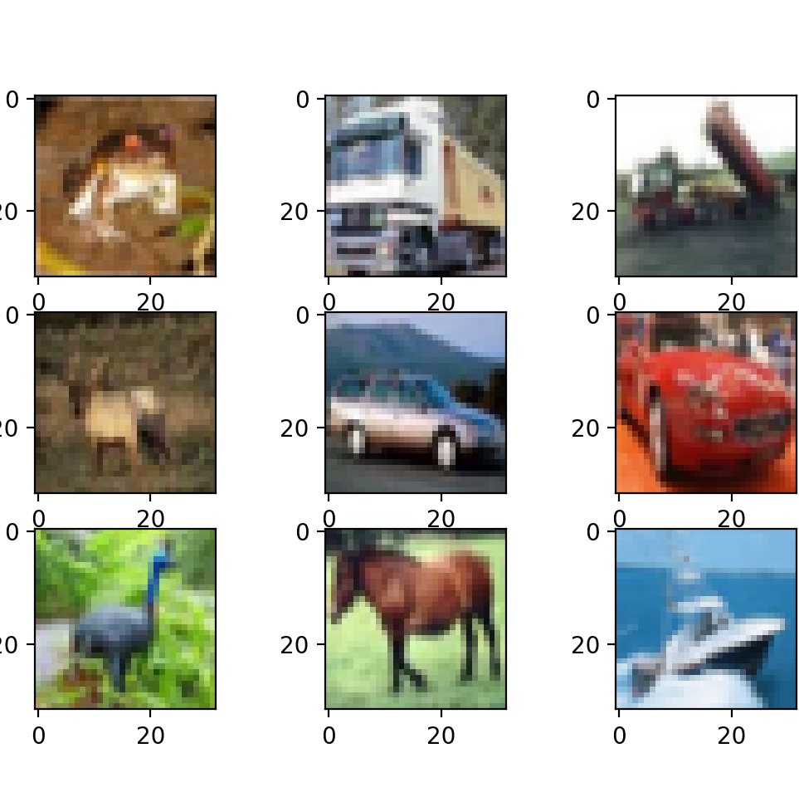
Abstract
Deep learning has significantly improved image recognition systems which can be applied in every aspect of our lives. In this project, I will build a Deep Neural Network (DNN) to recognize certain objects in some photo using CIFAR-10 dataset to predict one of ten classes of objects. adjust state of the art DNN for recognition of other new-objects but we don't need to do training again.
In this project, I will model a classification task with the CIFAR10 dataset using Keras.

Slide 3
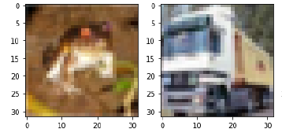
Dataset:
We have 50000 training and 10000 test images in the dataset. The images have a structure of (32,32,3) which correspond to (width, height, RGB color channels).
CIFAR10 http://www.cs.toronto.edu/~kriz/cifar.html
For each image there is a corresponding label, which is a class index.

Slide 4
Proposed method:
1- Loading the dataset
2- Examining the dataset
3- Preparing the dataset
4- Creating CNN model
5- Add dropout, batch normalization and data augmentation
6- Fits the model on batches with real-time data augmentation then start training

Slide 5
Evaluation method:
First with the “model.evaluate” command to compare the x-test input data and the y-test output:
Then showing the confusion matrix available with seaborn library that will point to the high values in its diagonal axis:

Slide 6
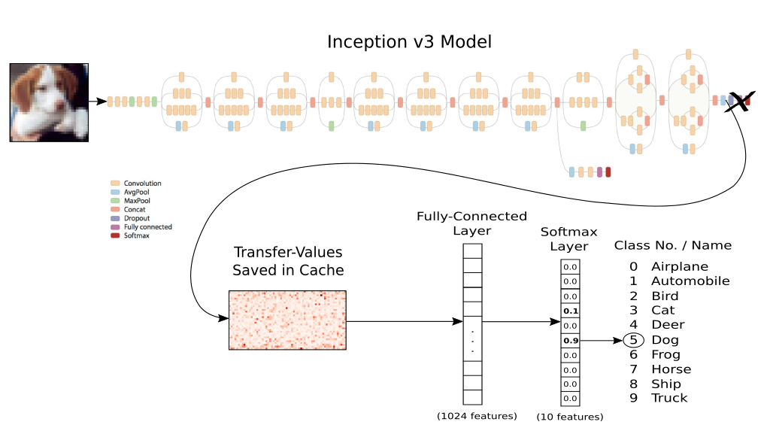
Transfer learning

Slide 7
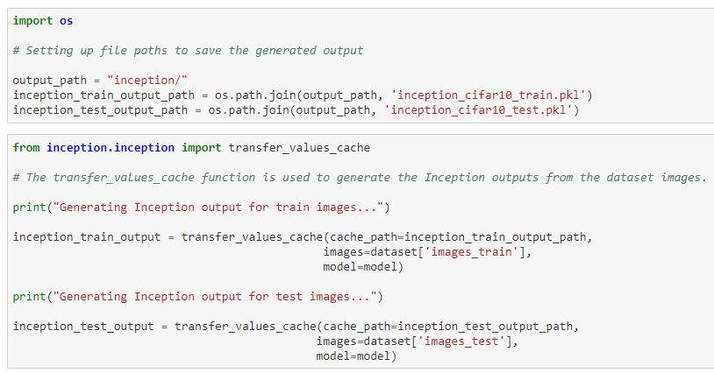
Transfer learning

Slide 8
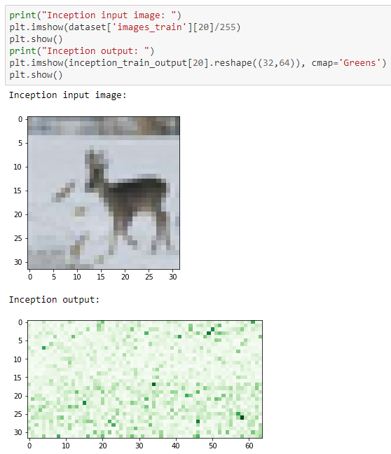
Transfer learning

Slide 9
Results and discussion:
CNN’s are translation invariant.
larger models have a tendency to overfit so Regularization methods
Dropout, Batch normalization, Data Augmentation
In my case the size of the dataset is large enough and no need for augmentation.
We can Introduce pretrained networks like Inception V3, and apply transfer learning.
Fine tune the model and change hyperparameters.

Slide 10


